Slide 1
LearnPlatform COVID-19
Impact on Digital Learning
Group 19: 王馨、張凱傑、艾芯、莊鎧爾

Slide 2
Outline
Introduction
Districts Data Statistics
Product Category Prediction
District Engagement Prediction

Slide 3
Introduction

Slide 4
Datasets
Engagement data: 233 個地區資料
time: 2020/01/01-2020/12/31
lp_id: 產品代號
pct_access: 一天中至少瀏覽一頁特定網站的人數比例
engagement_index: 一天中每一千人瀏覽特定網站的數量

Slide 5
Datasets
District information data
district_id: 233 個地區對應代號
state: 美國各州名
locale: 地區 (City/Suburb/Town/Rural)
pct_black/hispanic: 黑人 or 西班牙裔之學生比例
pct_free/reduced: 獲免費 or 減價午餐之學生比例
county_connections_ratio: 網速 > 200kbps 的家庭比例
pp_total_raw: 政府對學區補助之中位數

Slide 6
Datasets
Product information data
lp_id: 產品代號
URL: 產品網址
Product Name: 產品名稱
Provider/Company Name: 發行公司
Sector(s): 使用該產品之教育部門
Primary Essential Function: 產品功能分類

Slide 7
Orientation
Districts Data Statistics (地區資訊統計與分析)
Product Category Prediction (產品種類預測)
District Engagement Prediction (地區參與程度預測)

Slide 8
Districts Data Statistics

Slide 9
Data preprocess
233 districts
Engagement data during 2020-1-1 to 2020-12-31 for each district
state
locale
pct_black/Hispanic
pct_free/reduced
county_connections_ratio (ignore)
pp_total_raw
177 districts
Removing districts with more than 20 missing data

Slide 10
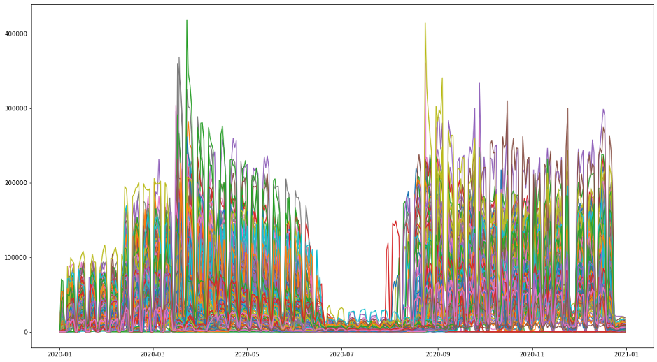
Daily data sum for each district

Slide 11
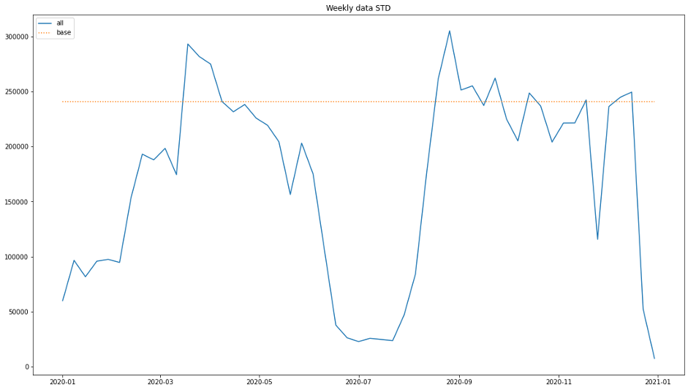
Weekly data STD for all

Slide 12
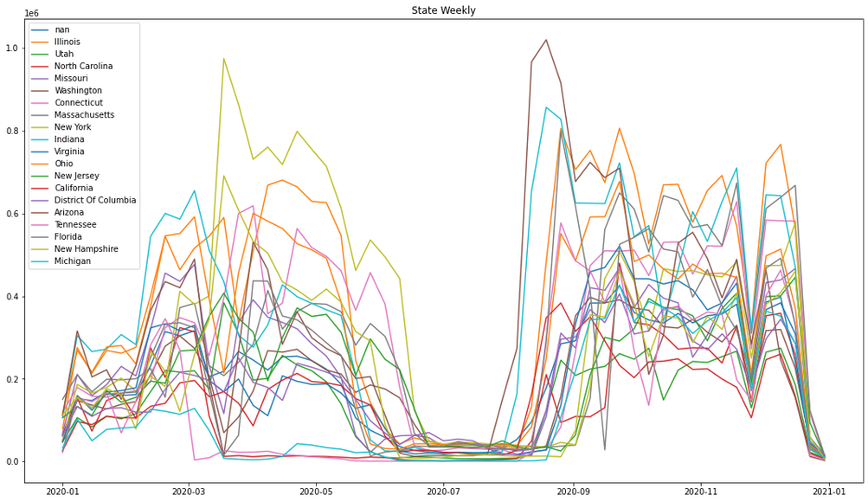
Weekly data sum for each state

Slide 13
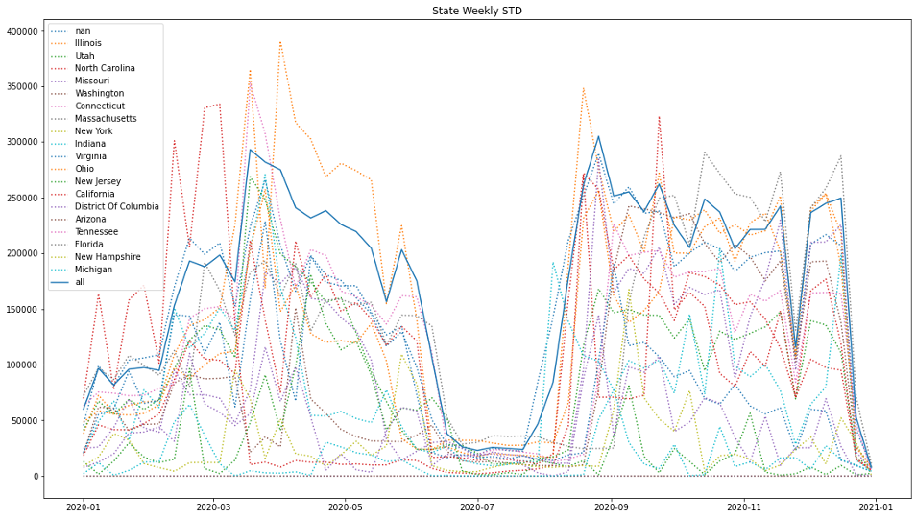
Weekly data STD for each state

Slide 14
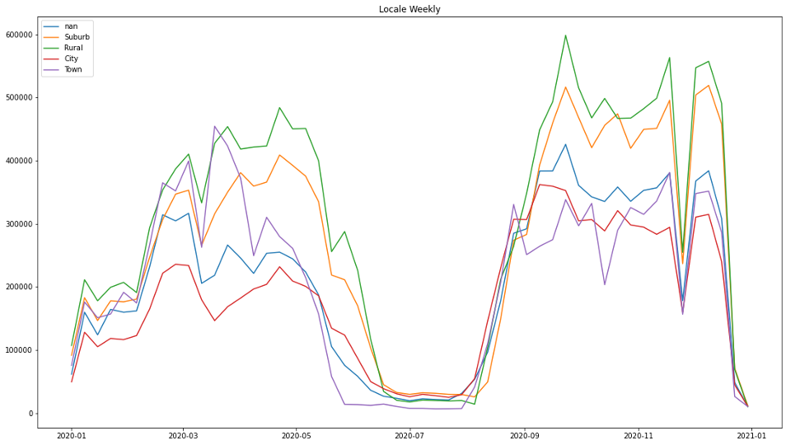
Weekly data sum for each locale

Slide 15
Correlation Coefficient
pct_black/Hispanic and engagement: -0.0625
pct_free/reduced and engagement: -0.0981
pp_total_raw and engagement: 0.157

Slide 16
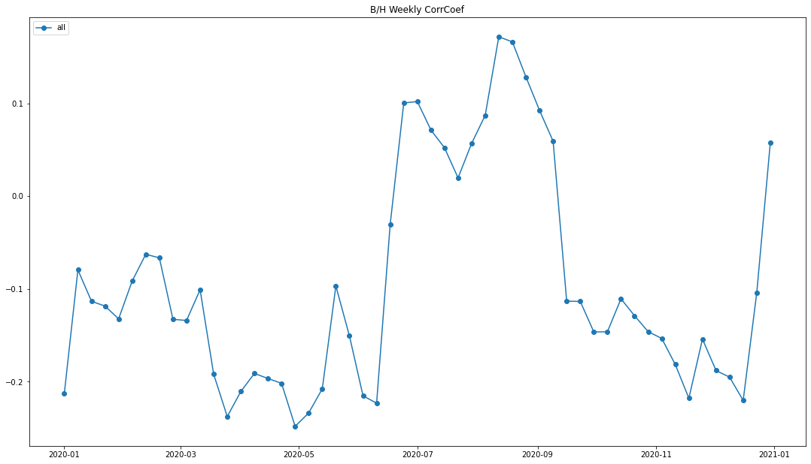
Weekly data between pct_black/Hispanic and target

Slide 17
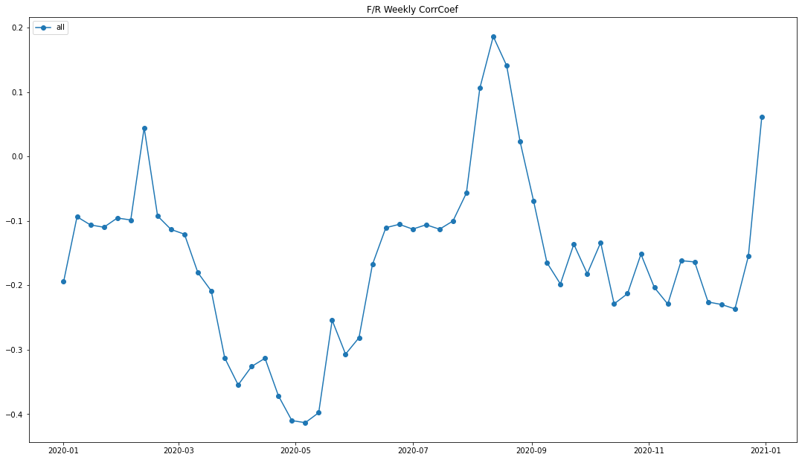
Weekly data between pct_free/reduced and target

Slide 18
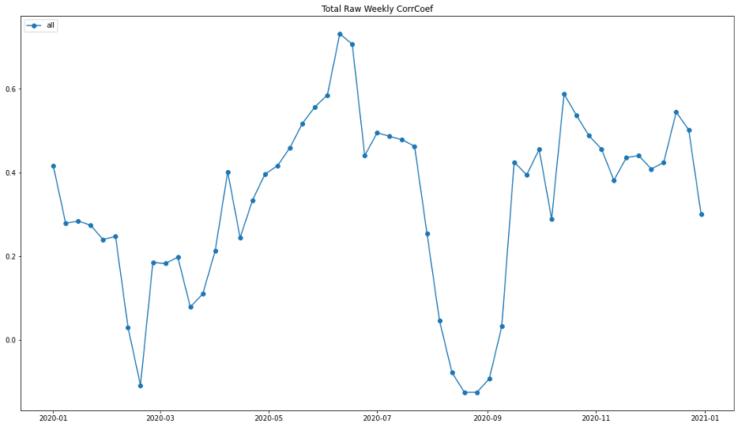
Weekly data between pp_total_raw and target

Slide 19
Results
數據結果
學生參與度與休假時間高度相關
相同 State 的學生參與度較相近
人種、午餐補助與學生參與度無關
政府補助與學生參與度正相關
結論
學生對線上學習資源的使用程度與學校的授課方式有大程度的相關性
學校授課方式只會跟地區、補助有較大相關性，與人種、午餐補助無關

Slide 20
Product Category Prediction

Slide 21
Product Category Prediction
Purpose
Forecast product category by difference region range
Method
region : ‘locale’, ‘state’, ‘district’
target : ‘primary_function_main’, ‘primary_function_sub’
train/test rate : 0.8/0.2
Model
DecisionTree
Bagging
Random Forests

Slide 22
Data preprocess
Data cleaning
District data:
Method: drop nan ‘state’
Product data:
Method: drop nan ‘Sector(s)’
Drop other feature : ‘Product Name’, ‘Provider/Company Name’
Product feature spliting
Method:
Sector(s) split into ‘sector_Corporate’, ‘sector_HigherEd’, ‘sector_PreK-12’
Primary Essential Function split into ‘primary_function_main’, ‘primary_function_sub’

Slide 23
Data preprocess
One-hot encoding
feature :
pct_black/hispanic
pct_free/reduced
pp_total_raw
Data merge
method : merge three data with ‘district_id’ & ‘LP ID’

Slide 24
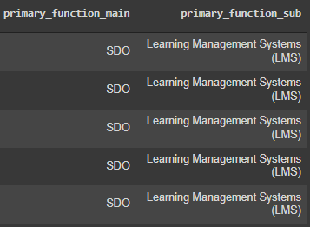
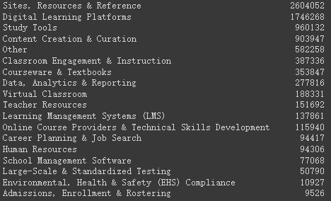

Product feature spliting
18 classes
4 classes

Slide 25
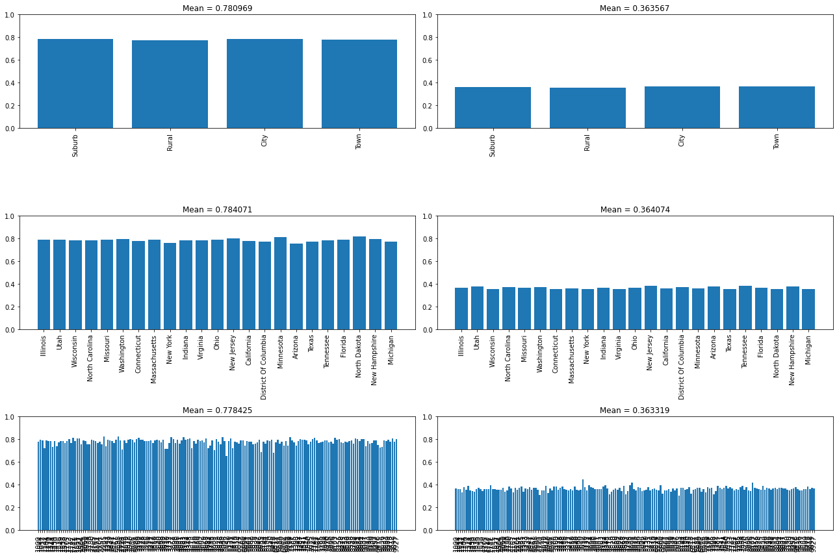
Decision Tree
function_main
function_sub
locale
state
district

Slide 26
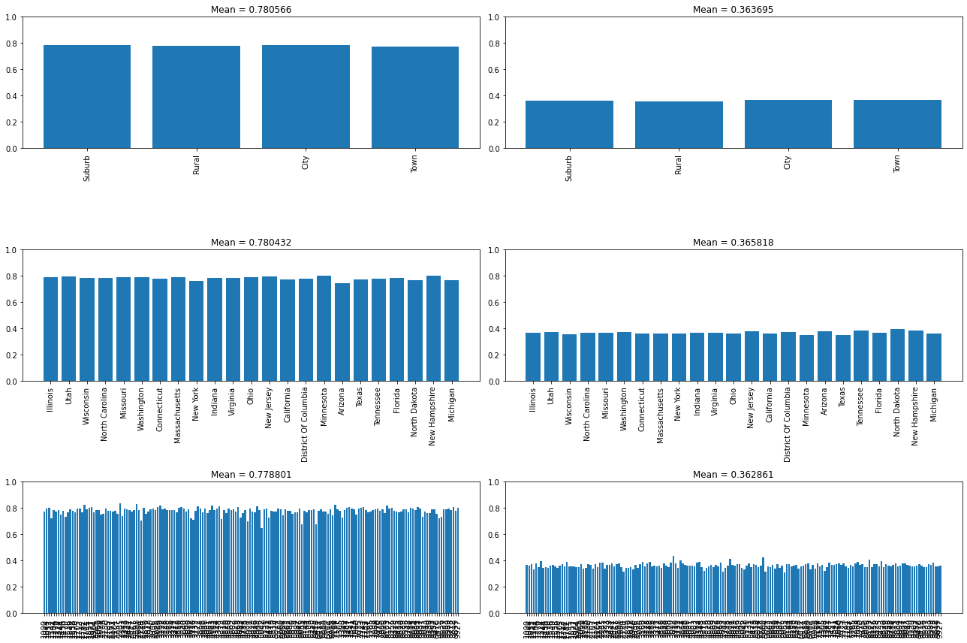
Bagging
function_main
function_sub
locale
state
district

Slide 27

Random Forests
function_main
function_sub
locale
state
district

Slide 28
Decision Tree
以 Decision Tree 為分類器並移除特徵 sector(s)
子類別正確率下降
drop sector(s) | function_main | function_sub
locale | 0.78 → 0.77 | 0.36 → 0.30
state | 0.78 → 0.77 | 0.36 → 0.29
district | 0.77 → 0.76 | 0.36 → 0.30

Slide 29
Results
使用不同 model 或地區範圍所得結果差異不大。
特徵「Sector」影響子類別預測正確率，意即使用此產品教育單位對子類別為正相關。

Slide 30
District Engagement Prediction

Slide 31
District Engagement Prediction
Purpose
Predict engagement index of each district

Slide 32
Data preprocessing
Data mapping & numeralization
Add holiday/weekend features
Add data from the previous days as features
Normalization

Slide 33
Data preprocessing
Data mapping & numeralization
Feature name | Mapping method
locale | City: 4, Suburb: 3, Town: 2, Rural: 1
pct_black/hispanic | [0, 0.2[: 1, [0.2, 0.4[: 2,[0.4, 0.6[: 3, [0.6, 0.8[: 4, [0.8, 1[: 5
pct_free/reduced | [0, 0.2[: 1, [0.2, 0.4[: 2,[0.4, 0.6[: 3, [0.6, 0.8[: 4, [0.8, 1[: 5
pp_total_raw | [4000, 6000[: 5, [6000, 8000[: 7, [8000, 10000[: 9, [10000, 12000[: 11, [12000, 14000[: 13, [14000, 16000[: 15, [16000, 18000[: 17, [18000, 20000[: 19, [20000, 22000[: 21, [22000, 24000[: 23, [32000, 34000[: 33

Slide 34
Data preprocessing
Add holiday/weekend features
Holiday | Date start | Date end
Winter break | 2019/12/20 | 2020/1/1
Midwinter break | 2020/2/17 | 2020/2/21
Spring break | 2020/4/20 | 2020/4/24
Summer break | 2020/6/22 | 2020/9/8
Rosh Hashanah break | 2020/9/18 | 2020/9/18
Thanksgiving break | 2020/11/26 | 2020/11/28
Christmas break | 2020/12/21 | 2021/1/1
Reference: https://www.mykidstime.com/school/here-are-the-school-holidays-2019/
https://www.edarabia.com/school-holidays-united-states/

Slide 35
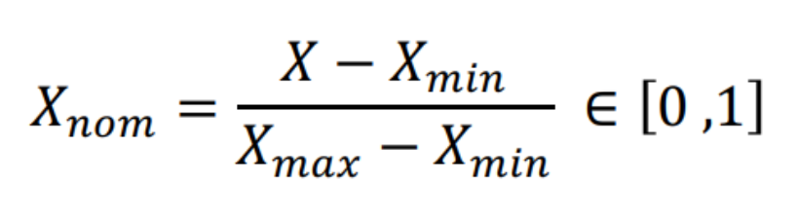
Data preprocessing
Add data from the previous days as features
1 day
3 days
7 days
10 days
14 days
Normalization
Normalize data to range(0,1)
Formula:

Slide 36
Model training
Method
target : ‘engagement_index’
train/test rate : 0.8/0.2
optimizer: Adam
loss calculation: RMSE
Hyper-parameter tuning
Parameters | Value
n_epochs | 5000
batch_size | 128
learning_rate | 0.001
weight_decay | 0.0005
betas | (0.9, 0.999)
early_stop | 350

Slide 37
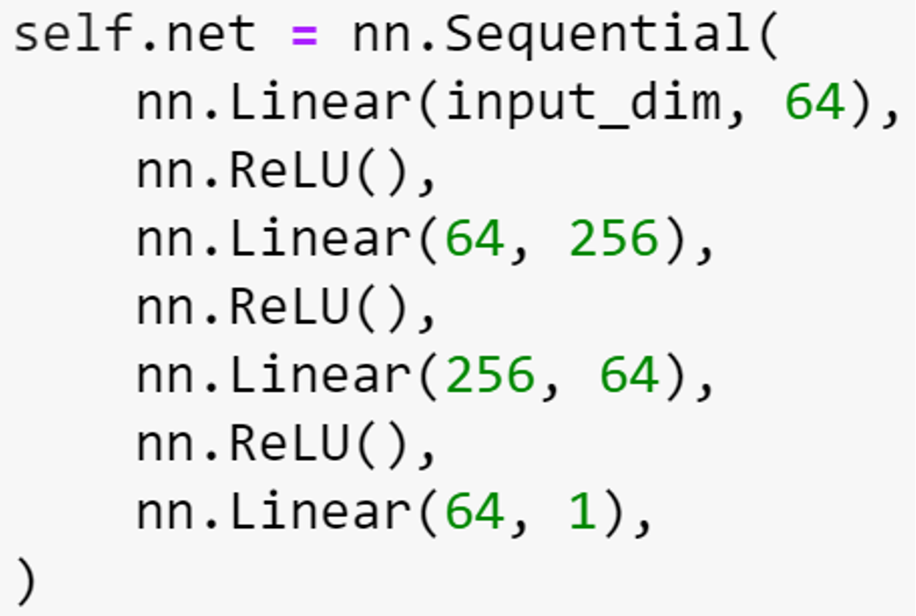
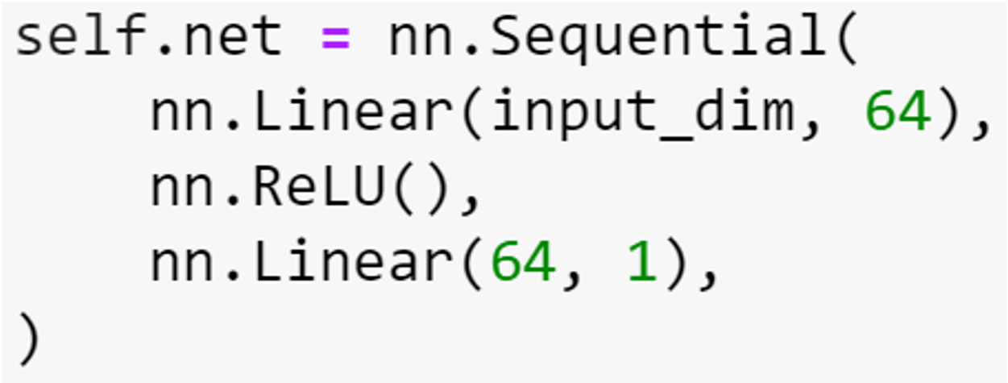
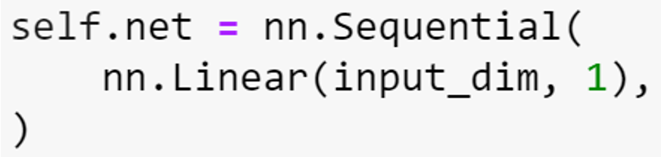
Model training
Model
Regression
One-layer perceptron (OLP)
Multilayer perceptron (MLP)
Regression
One-layer perceptron (OLP)
Multilayer perceptron (MLP)

Slide 38
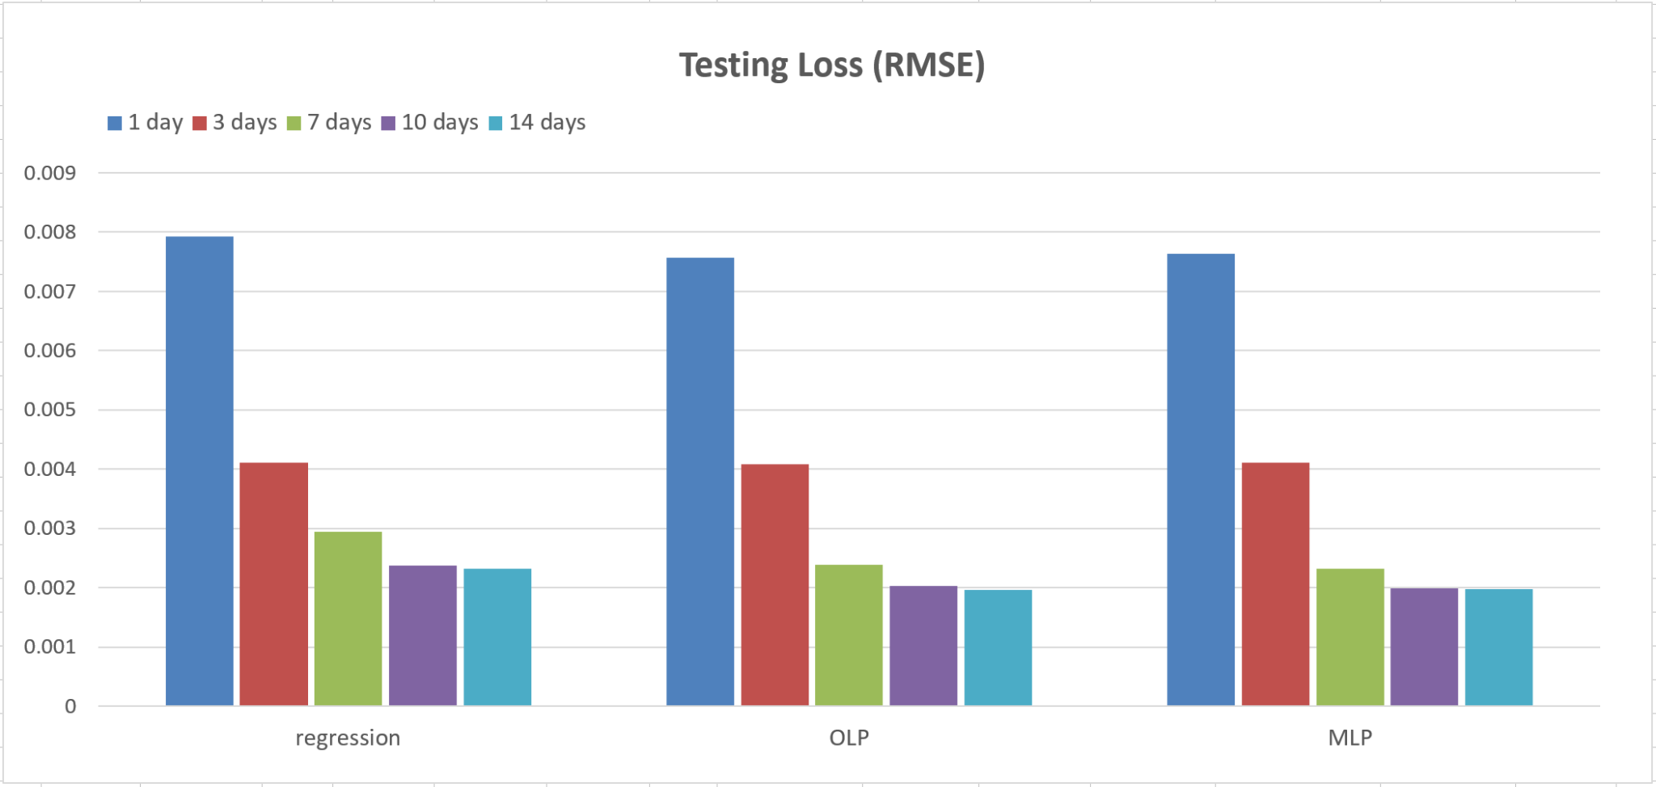
Results - RMSE

Slide 39
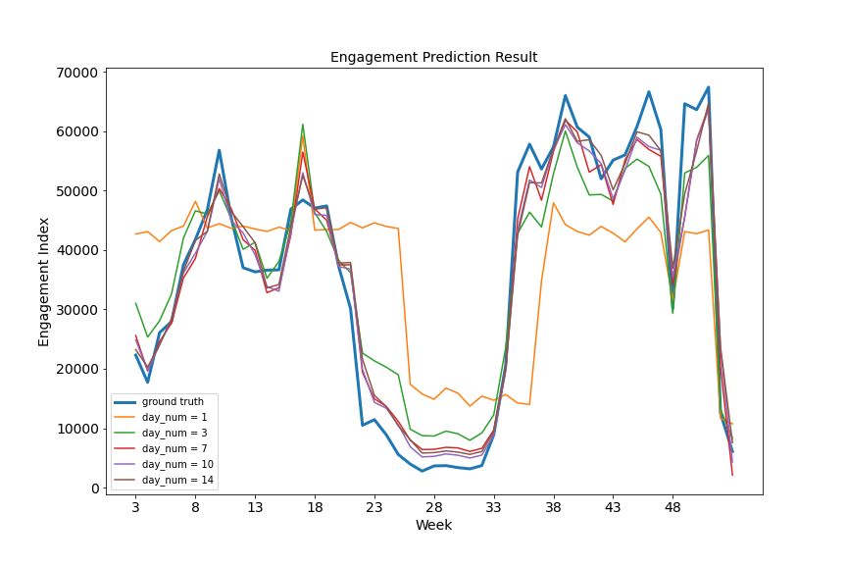
Results - prediction result (regression)

Slide 40
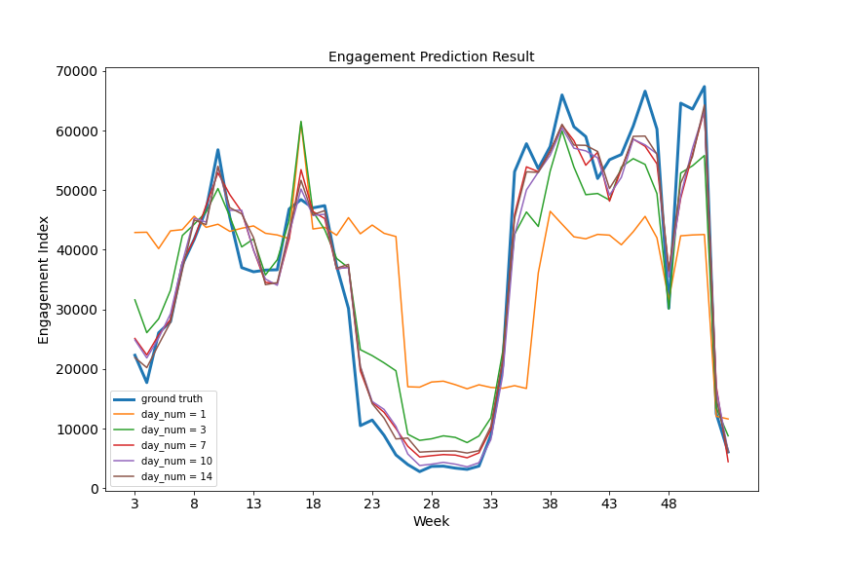
Results - prediction result (OLP)

Slide 41
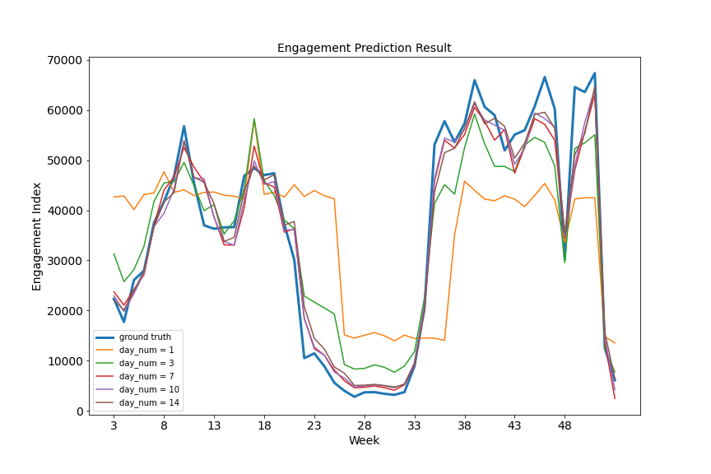
Results - prediction result (MLP)

Slide 42
Results
使用三種 model 都可得到相當好的結果
隨著收集資料的天數增加，預測結果越好

Slide 43
Thank you for your attention!

